Slide 1




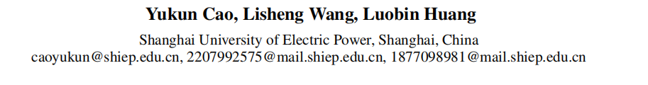



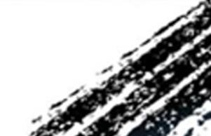

ATAI
Advanced Technique of Artificial Intelligence
ATAI
ChongqingUniversity _{AdvancedTechniqueof}
of Technology Artificial Intelligence
Chongqing University of
Technology
Chongqing University ^{ATAI}
_{of Technology} Advanced Techniqueof
Artificial Intelligence
Chongqing University of Technology
Chongqing University of Technology
DPCL-Diff: Temporal Knowledge Graph Reasoning Based on Graph Node
Diffusion Model with Dual-Domain Periodic Contrastive Learning
Code:None
——AAAI 2025
Reported by Xiang Zhang
1

Slide 2
ATAI
Advanced Technique of Artificial Intelligence
ATAI
ChongqingUniversity _{AdvancedTechniqueof}
of Technology Artificial Intelligence
Chongqing University of
Technology
Chongqing University ^{ATAI}
_{of Technology} Advanced Techniqueof
Artificial Intelligence
Chongqing University of Technology
Chongqing University of Technology
Motivation
Temporal knowledge graph (TKG) reasoning that infers future missing facts is an essential and challenging task. Predicting future events typically relies on closely related historical facts,yielding more accurate results for repetitive or periodic events.
1)in actual reasoning tasks, some periodic events share the same head entities and relations, differing only in their tail entities. This results in overly similar representations, making it difficult to distinguish them during reasoning
2)In event-based TKG, new events that have never occurred account for about 40% . Due to the sparse traces of temporal interactions throughout the timeline of these new events, it is impossible to use reasoning methods based on high-frequency periodic events, resulting in poor reasoning performance for these types of events.

Slide 3
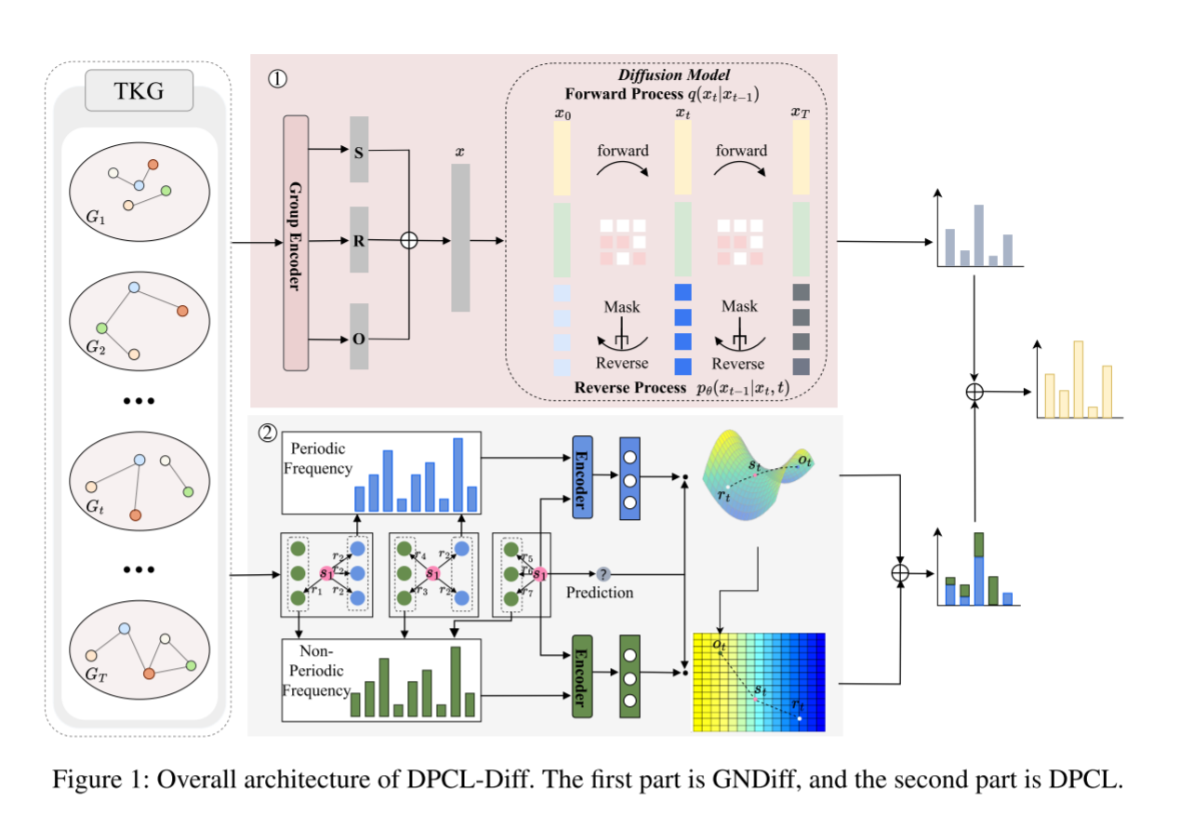
ATAI
Advanced Technique of Artificial Intelligence
ATAI
ChongqingUniversity _{AdvancedTechniqueof}
of Technology Artificial Intelligence
Chongqing University of
Technology
Chongqing University ^{ATAI}
_{of Technology} Advanced Techniqueof
Artificial Intelligence
Chongqing University of Technology
Chongqing University of Technology
Overview

Slide 4
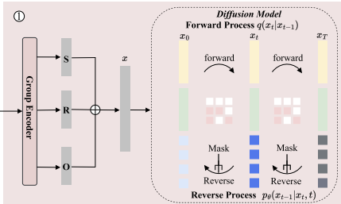

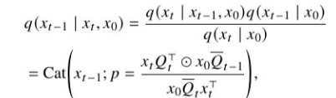

ATAI
Advanced Technique of Artificial Intelligence
ATAI
ChongqingUniversity _{AdvancedTechniqueof}
of Technology Artificial Intelligence
Chongqing University of
Technology
Chongqing University ^{ATAI}
_{of Technology} Advanced Techniqueof
Artificial Intelligence
Chongqing University of Technology
Chongqing University of Technology
Method
GNDiff includes a forward and a reverse diffusion process.
For each quadruple (𝑠, 𝑟, 𝑜, 𝑡), the vector representations of 𝑠,𝑟, and 𝑜are concatenated, forming a single vector as input to the graph node diffusion model.The noise addition
process is represented by a stack of heat vectors as shown in
Equation.

Slide 5
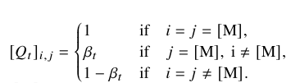
ATAI
Advanced Technique of Artificial Intelligence
ATAI
ChongqingUniversity _{AdvancedTechniqueof}
of Technology Artificial Intelligence
Chongqing University of
Technology
Chongqing University ^{ATAI}
_{of Technology} Advanced Techniqueof
Artificial Intelligence
Chongqing University of Technology
Chongqing University of Technology
Method
Here, [M] denotes a node in a masked state (an inactive node), allowing nodes to transition naturally in and out of this state as the graph evolves, eventually converging to a smooth distribution 𝑞(𝑥𝑇). This approach concentrates all probability mass on a sequence labelled with a mask.

Slide 6

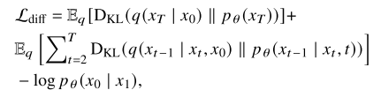
ATAI
Advanced Technique of Artificial Intelligence
ATAI
ChongqingUniversity _{AdvancedTechniqueof}
of Technology Artificial Intelligence
Chongqing University of
Technology
Chongqing University ^{ATAI}
_{of Technology} Advanced Techniqueof
Artificial Intelligence
Chongqing University of Technology
Chongqing University of Technology
Method
Samples are then generated through a backward diffusion process
We optimize the inverse process by minimizing the variational lower bound to maximize the log likelihood of the original data

Slide 7

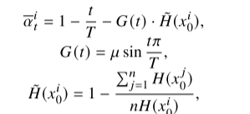
ATAI
Advanced Technique of Artificial Intelligence
ATAI
ChongqingUniversity _{AdvancedTechniqueof}
of Technology Artificial Intelligence
Chongqing University of
Technology
Chongqing University ^{ATAI}
_{of Technology} Advanced Techniqueof
Artificial Intelligence
Chongqing University of Technology
Chongqing University of Technology
Method
low information tokens appear earlier in the reverse process than high information ones.

Slide 8
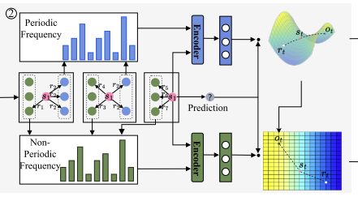
ATAI
Advanced Technique of Artificial Intelligence
ATAI
ChongqingUniversity _{AdvancedTechniqueof}
of Technology Artificial Intelligence
Chongqing University of
Technology
Chongqing University ^{ATAI}
_{of Technology} Advanced Techniqueof
Artificial Intelligence
Chongqing University of Technology
Chongqing University of Technology
Method
we map entities from periodic and non periodic events to Poincar´e and Euclidean spaces, respectively, to identify
highly correlated entities within each domain. By leveraging the spatial characteristics of Poincar´e space, we more accurately capture the relationships between periodic entities and distinguish similar ones.

Slide 9

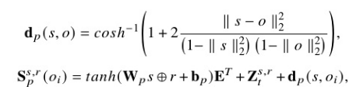
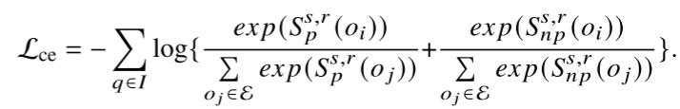
ATAI
Advanced Technique of Artificial Intelligence
ATAI
ChongqingUniversity _{AdvancedTechniqueof}
of Technology Artificial Intelligence
Chongqing University of
Technology
Chongqing University ^{ATAI}
_{of Technology} Advanced Techniqueof
Artificial Intelligence
Chongqing University of Technology
Chongqing University of Technology
Method
During data preprocessing, we analyze entity frequencies for a given query
The distance between entities in Poincar´e space is used as the final similarity score between an entity O𝑖 ∈ E and a query 𝑞.
For non-periodic dependencies, we calculate the similarity scores 𝑑𝐸 (𝑠, 𝑜) =∥ 𝑠 − 𝑜 ∥ using the following Euclidean distance formula to obtain the non-periodic dependency score

Slide 10

ATAI
Advanced Technique of Artificial Intelligence
ATAI
ChongqingUniversity _{AdvancedTechniqueof}
of Technology Artificial Intelligence
Chongqing University of
Technology
Chongqing University ^{ATAI}
_{of Technology} Advanced Techniqueof
Artificial Intelligence
Chongqing University of Technology
Chongqing University of Technology
Method
where 𝐼 is the set of positive samples, 𝑃(𝑖) is the set of queries with the same label in the small batch, 𝑧𝑞 denotes the
embedding vector of query 𝑞, 𝑧 𝑝 represents the embedding vector of queries sharing the same label as 𝑞, 𝑧𝑎 denotes the embedding vector of all non-𝑞 queries in the small batch.

Slide 11
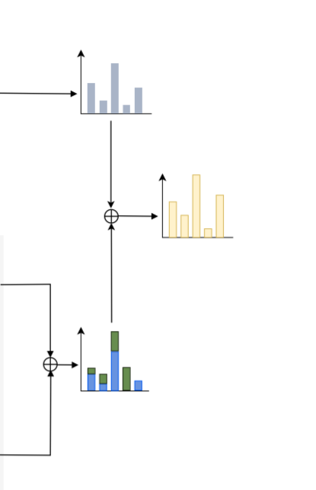




ATAI
Advanced Technique of Artificial Intelligence
ATAI
ChongqingUniversity _{AdvancedTechniqueof}
of Technology Artificial Intelligence
Chongqing University of
Technology
Chongqing University ^{ATAI}
_{of Technology} Advanced Techniqueof
Artificial Intelligence
Chongqing University of Technology
Chongqing University of Technology
Method

Slide 12
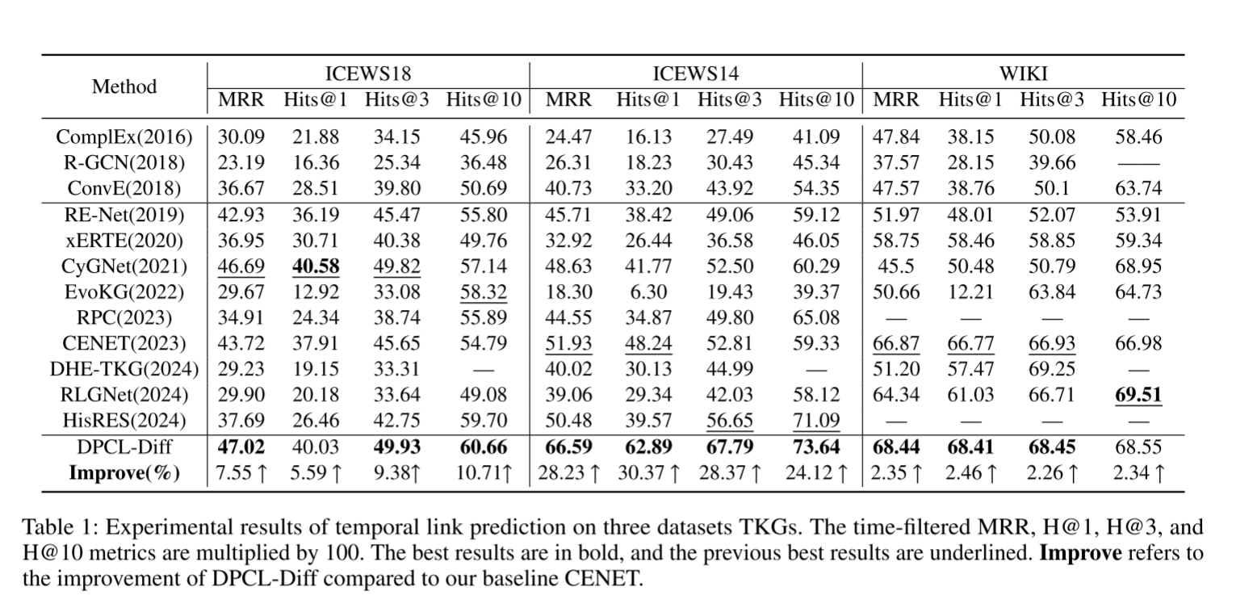
ATAI
Advanced Technique of Artificial Intelligence
ATAI
ChongqingUniversity _{AdvancedTechniqueof}
of Technology Artificial Intelligence
Chongqing University of
Technology
Chongqing University ^{ATAI}
_{of Technology} Advanced Techniqueof
Artificial Intelligence
Chongqing University of Technology
Chongqing University of Technology
Experiments

Slide 13
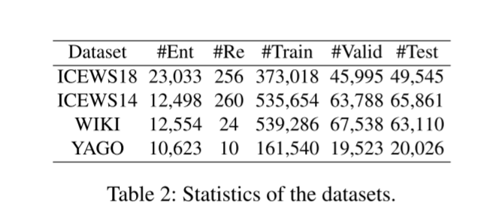
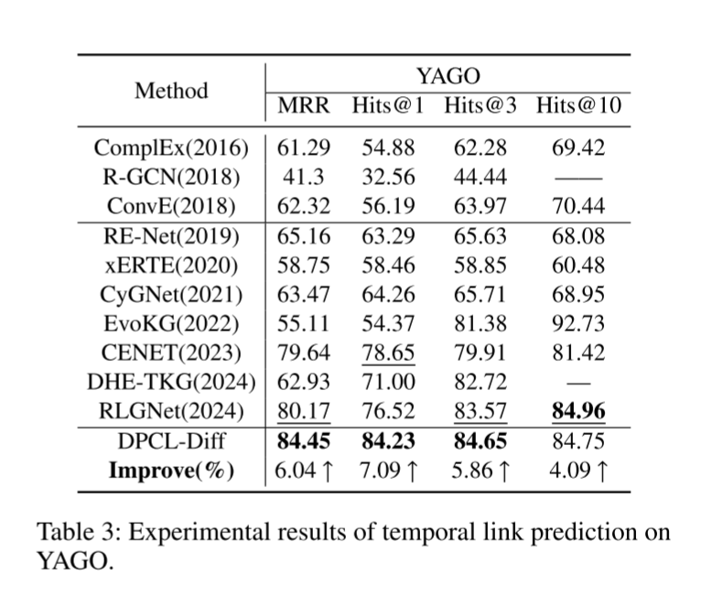
ATAI
Advanced Technique of Artificial Intelligence
ATAI
ChongqingUniversity _{AdvancedTechniqueof}
of Technology Artificial Intelligence
Chongqing University of
Technology
Chongqing University ^{ATAI}
_{of Technology} Advanced Techniqueof
Artificial Intelligence
Chongqing University of Technology
Chongqing University of Technology
Experiments

Slide 14
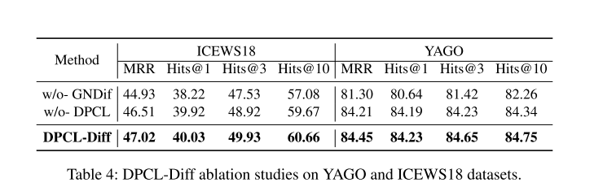
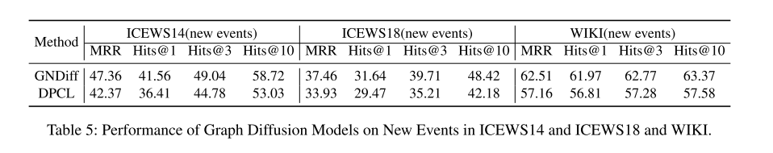
ATAI
Advanced Technique of Artificial Intelligence
ATAI
ChongqingUniversity _{AdvancedTechniqueof}
of Technology Artificial Intelligence
Chongqing University of
Technology
Chongqing University ^{ATAI}
_{of Technology} Advanced Techniqueof
Artificial Intelligence
Chongqing University of Technology
Chongqing University of Technology
Experiments

Slide 15
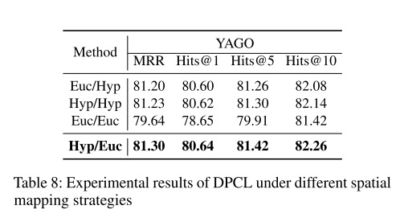
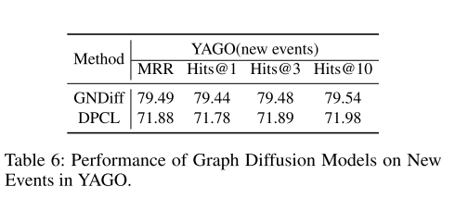
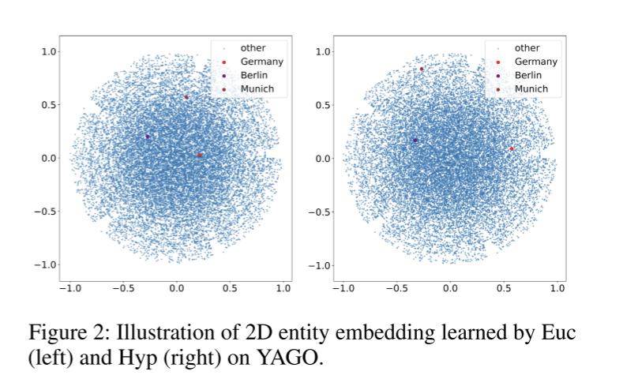
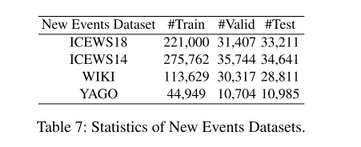
ATAI
Advanced Technique of Artificial Intelligence
ATAI
ChongqingUniversity _{AdvancedTechniqueof}
of Technology Artificial Intelligence
Chongqing University of
Technology
Chongqing University ^{ATAI}
_{of Technology} Advanced Techniqueof
Artificial Intelligence
Chongqing University of Technology
Chongqing University of Technology
Experiments

Slide 16
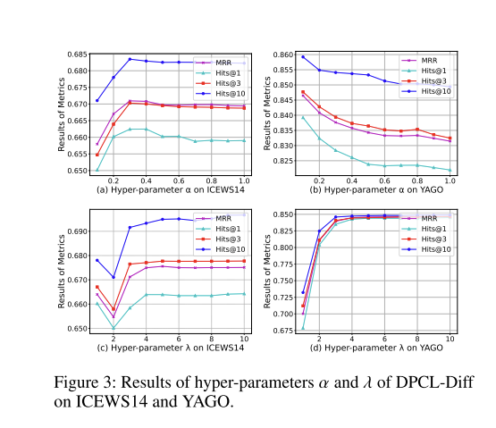
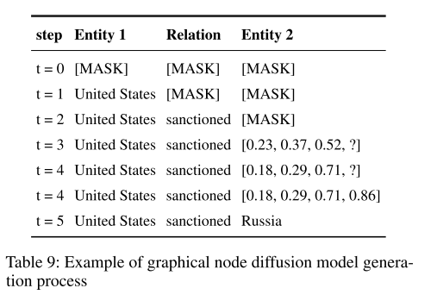
ATAI
Advanced Technique of Artificial Intelligence
ATAI
ChongqingUniversity _{AdvancedTechniqueof}
of Technology Artificial Intelligence
Chongqing University of
Technology
Chongqing University ^{ATAI}
_{of Technology} Advanced Techniqueof
Artificial Intelligence
Chongqing University of Technology
Chongqing University of Technology
Experiments

Slide 17


ATAI
Advanced Technique of Artificial Intelligence
ATAI
ChongqingUniversity _{AdvancedTechniqueof}
of Technology Artificial Intelligence
Chongqing University of
Technology
Chongqing University ^{ATAI}
_{of Technology} Advanced Techniqueof
Artificial Intelligence
Chongqing University of Technology
Chongqing University of Technology
Thanks!

